Slide 1
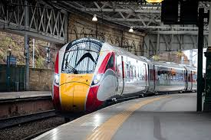

UK Train Rides Dashboard
DEPI3-Data Analysis_Power Bi

Slide 2

Prepared By
Ahmed Essam Eldin Abd Elfattah
Ahmed Ibrahim Abdelhamid
Amr Essam Fathy
Eslam Mohamed Abd Elfattah
Reham Mahmoud Moustafa Shaarawy

Slide 3
Project Overview
Our project focuses on analysis of UK railway operations from January to April 2024 using Power BI. . Our goal is to provide key insights to improve service performance and increase passenger satisfaction.

Slide 4
Data Description
The original dataset is CSV file which consists of 18 columns. The file was imported into Power BI Desktop for analysis.

Slide 5
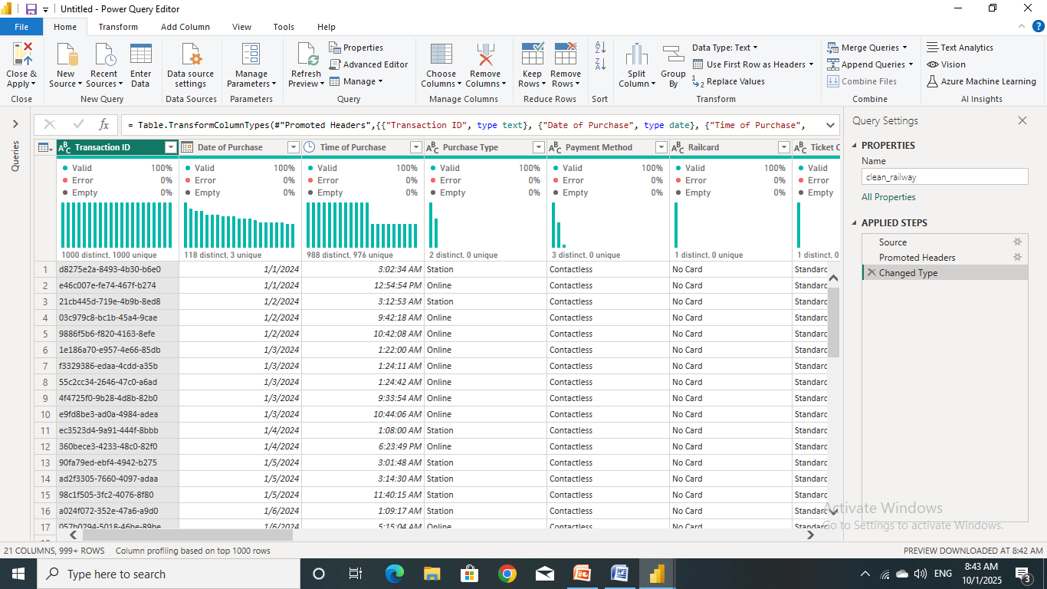
Data Cleaning
Power Query Editor (Before Cleaning)

Slide 6
Data Cleaning
The following steps were taken:
No duplicated records were found.
Replace “None” in Railcard column with “No Card”.
Replace blank in Reason for Delay column with “No Delay”.
Replace “Weather” in Reason for Delay column with “Weather Conditions”.
Replace “Staffing” in Reason for Delay column with “Staffing shortage”.
Replace “Signal failure” in Reason for Delay column with “Signal Failure”.
Add new column called “Reservation Period In Days”.
Add new column called “Delayed In Minutes”.
Add new column called “Day of Journey”.

Slide 7
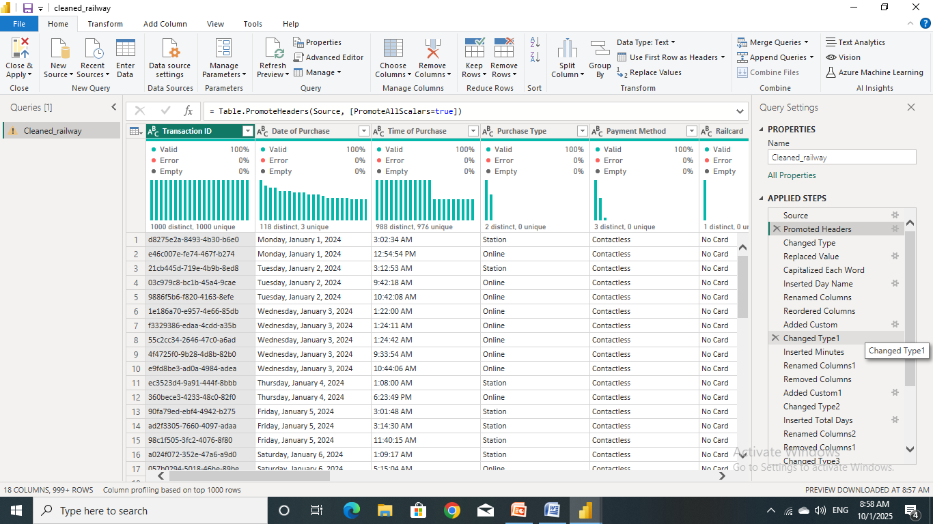
Data Cleaning
Power Query Editor (After Cleaning)

Slide 8
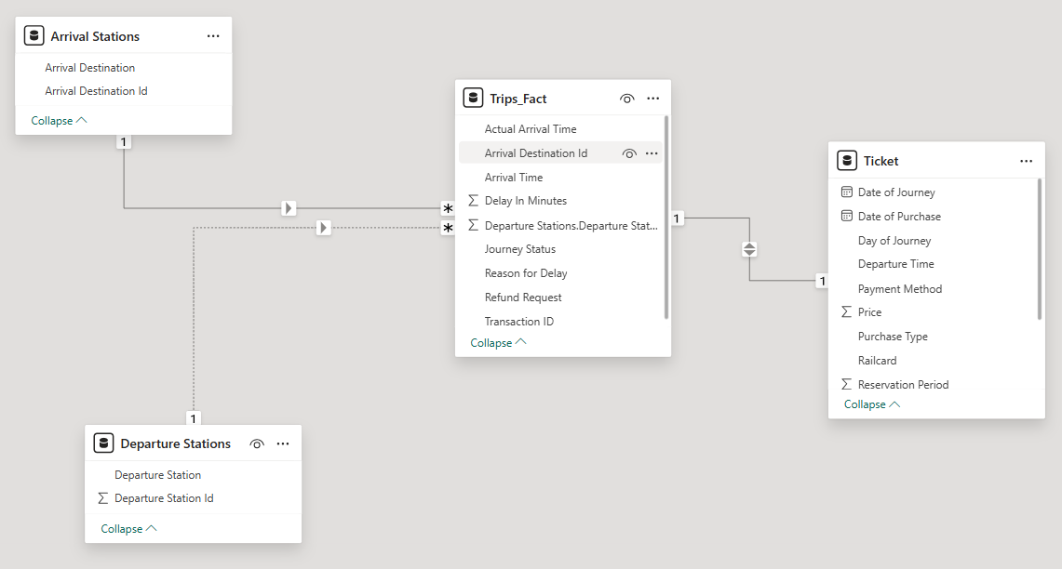
Data Modeling

